Slide 1

Final presentation – bachelors‘ thesis
Title: A Comparison of the Impact of Auction Formats Used in the 2015 German Spectrum Auction "Mobiles Breitband - Projekt 2016" Tim Berger Munich, 15th Sept 2016

Slide 2
Agenda
The German Auction in 2015
Comparison of the Auction Formats
Simulation Set-Up
Results
Conclusion and Future Work

Slide 3
The German Auction in 2015

Slide 4



The German Auction in 2015
Environment of the German Auction
Auction format: SMRA (Simultaneous Multi-Round Auction)
Duration: 4 weeks
Revenue: EUR 5.081bn
Frequency bands: 700 MHz (LTE),
900 MHz (LTE/GSM, cap at 3 blocks)
1800 MHz (LTE/GSM)
1500 MHz
Participants: TEF, DT, VOD
Notes:
- Complementarities in 900 and 1800 MHz

Slide 5
Comparison of the Auction Formats

Slide 6
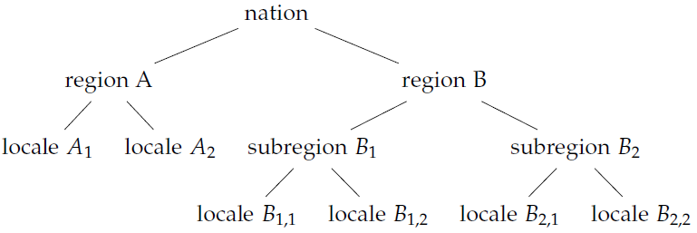
Auction Formats
SMRA (Simultaneous Multi-Round Auction)
HPB (Hierarchical Package Bidding)
Extension of English Auction with multiple items
Single item bids
Round based fashion with ascending prices and increments
Highest bid provisionally wins item
Set of actitivity rules (e.g. eligibility points)
Bidding until no new bids submitted
often resolves in efficient allocations [2]
Well established & simple format
Strategical challenges in environments with complementarities
Package bidding allowed
Items in tree like hierarchy [3]
Efficient computation of allocation & prices
Excess prices for packages handed down to item level “lump-sum taxes” [4]
Example of a HPB hierarchy

Slide 7
Simulation Set-Up

Slide 8
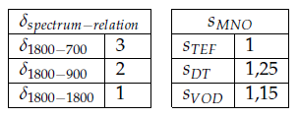
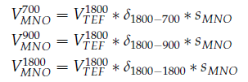

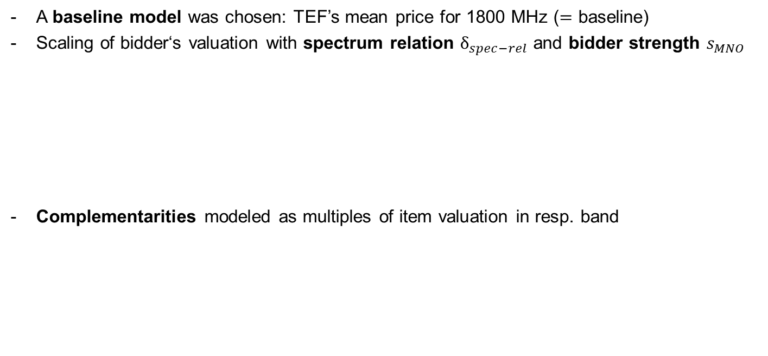
Simulation Set-Up
The Bidders‘ Valuation
A baseline model was chosen: TEF’s mean price for 1800 MHz ($=$ baseline)
Scaling of bidder‘s valuation with spectrum relation $δ_{spec−rel}$ and bidder strength $s_{MNO}$
Complementarities modeled as multiples of item valuation in resp. band
Notes:
- Prices function of strategy, not market values!
- Bidder strength chosen according to market share in service revenues in 2014

Slide 9
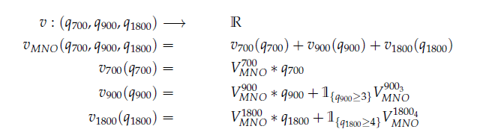
Simulation Set-Up
The Value Model
Bonuses based on [1]:
900 MHz: large incremental value for three blocks (2 LTE + 1 GSM or 3 GSM)
1800 MHz: blocks of 4 or 6 blocks (LTE), but only 4 item bundle modeled
Notes:
IPV with full exposure, no externalities
incorp. the bonuses of 900 and 1800 MHz based on [1]
Note: spectrum cap not implemented in VM -> Strategy / Selector

Slide 10
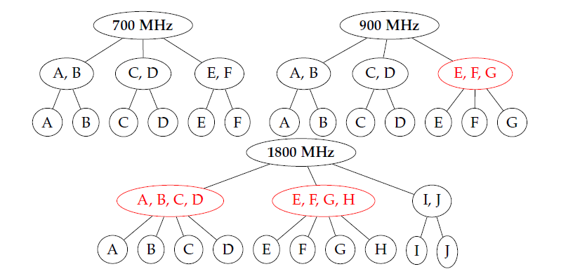
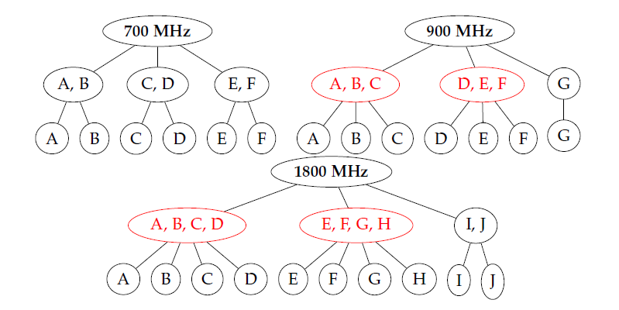


Simulation Set-Up
The HPB Hierarchies
two different hierarchies with varying competition levels
explore effect of hierarchy on auction performance
$$H_{competition}$$
$$H_{vm−predict}$$
*red packages induce bonus
*red packages induce bonus

Slide 11
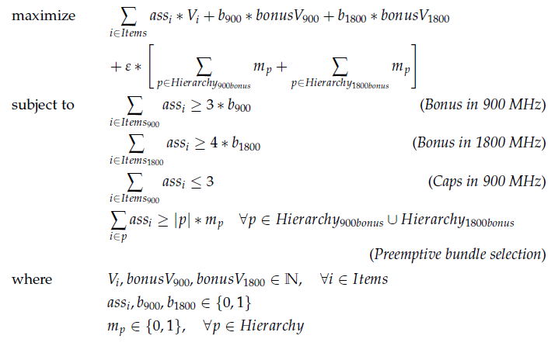
Simulation Set-Up
The Selector Model (MILP, extension of an Additive Payoff Selector)
Notes:
- Naive exhaust: 4.1 x 10^6 and 25.1 x 10^6

Slide 12
Results

Slide 13
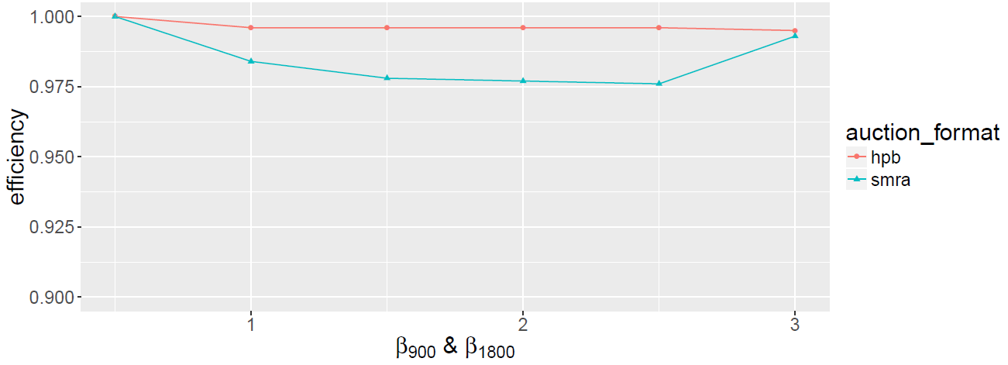
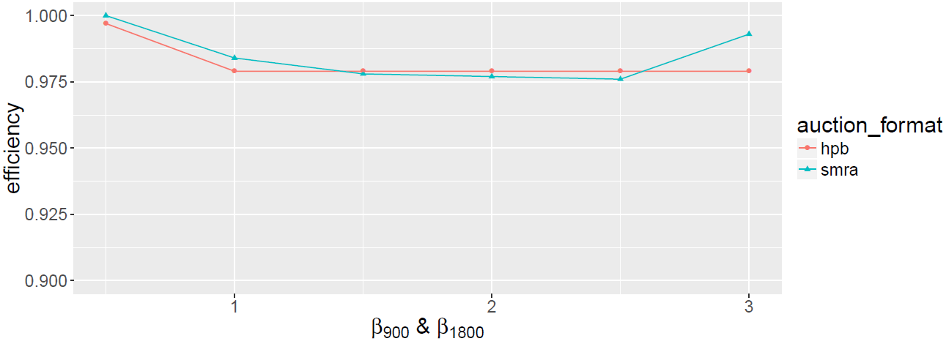


Results
Efficiency – impact of the bonus valuation β and the hierarchies
$$H_{competition}$$
$$H_{vm−predict}$$

Slide 14
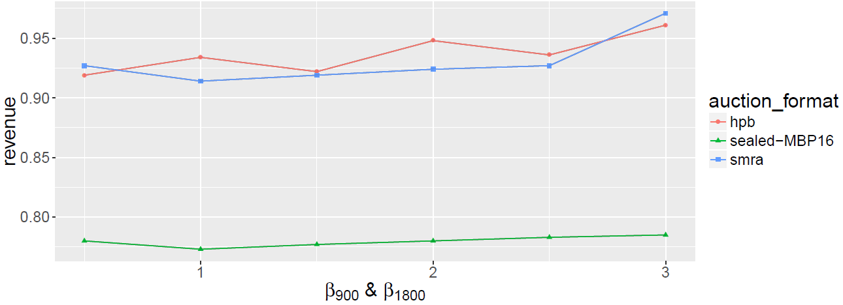
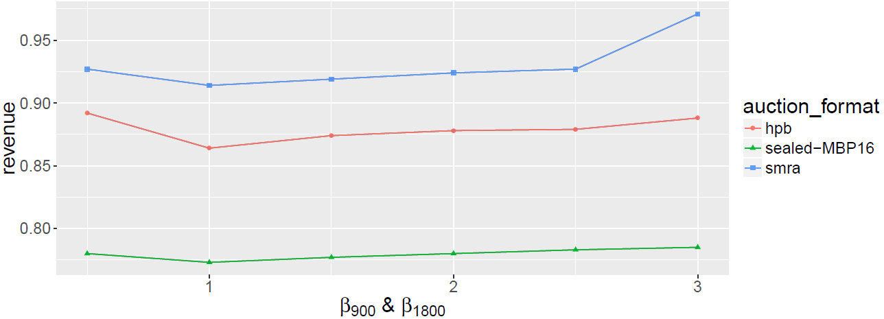


Results
Revenue – impact of the bonus valuation β and the hierarchies
$$H_{competition}$$
$$H_{vm−predict}$$

Slide 15
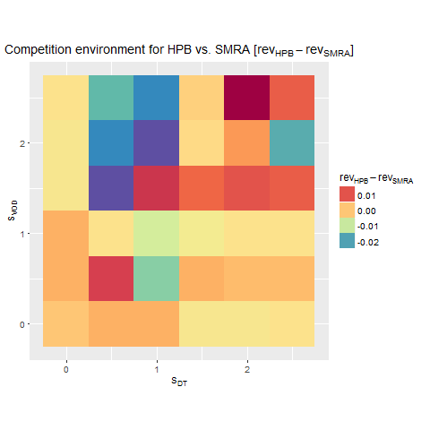
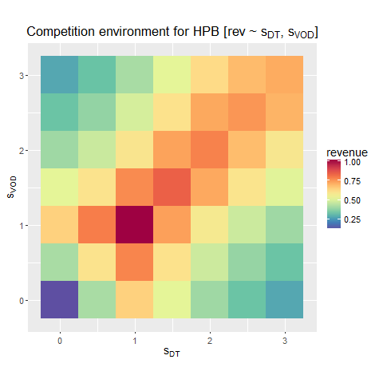
Results
Revenue – impact of the competition environment ($H_{competition}$)

Slide 16
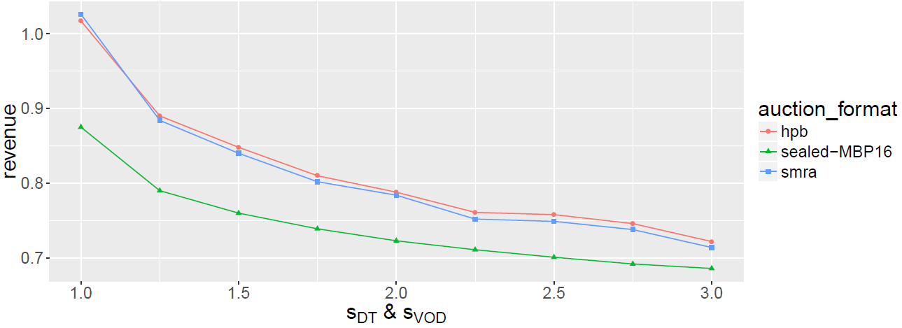
Results
Revenue – impact of the competition environment ($H_{competition}$)

Slide 17
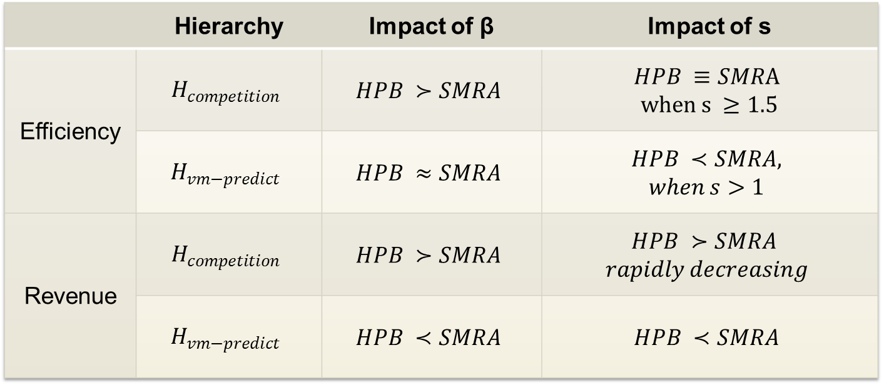
Summary of the Results
 | Hierarchy | Impact of β | Impact of s
Efficiency | $$H_{competition}$$ | $$HPB ≻SMRA$$ | $$HPB ≡SMRA$$ $$when s ≥1.5$$
 | $$H_{vm−predict}$$ | $$HPB ≈SMRA$$ | $$HPB ≺SMRA,$$ $$when s>1$$
Revenue | $$H_{competition}$$ | $$HPB ≻SMRA$$ | $$HPB ≻SMRA$$ $$rapidly decreasing$$
 | $$H_{vm−predict}$$ | $$HPB ≺SMRA$$ | $$HPB ≺SMRA$$

Slide 18
Conclusion and Future Work
HPB might help to improve bidder communication
more efficient allocations
less revenue
HPB performance was more stable in relation to different valuations of complementarities
Hierarchy greatly influences auction outcome
SMRA performed better in less competitive hierarchy
→ Hierarchy is key for well perfoming HPB auctions
>

Slide 19
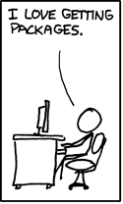
Thank you for your attention!
[5]

Slide 20
References
[1] M. Bichler, V. Gretschko, and M. Janssen. “Bargaining in Spectrum Auctions:
A Review of the German Auction in 2015.” 2016.
[2] M. Bichler. The Simultaneous Multi-Round Auction Format. Munich: Technical
University Munich, 2016, pp. 99–110.
[3] M. H. Rothkopf, A. Pekeˇc, and R. M. Harstad. “Computitional Manageable
Combinatitional Auction.” In: Management science 44 (1998), pp. 1131–1147.
[4] J. K. Goeree and C. A. Holt. “Hierarchical package bidding: A paper &
pencil combinatorial auction.” In: Games and Economic Behavior 70.1 (2010),
pp. 146–169.
[5] https://xkcd.com/576/

Slide 21
Backup

Slide 22
The German Auction in 2015
Environment of the German Auction
Auction format | SMRA (Simultaneous Multi-Round Auction)
Duration | 4 weeks
Revenue | EUR 5.081bn
Frequency bands: | 700, 900, 1800, 1500 MHz
Participants | TEF, DT, VOD

